Slide 1
Snake Game

Slide 2
Group Members
Md. Sharif Hasnat ID: 011 143 003
Shamim-Al-Mamun ID: 011 143 009

Slide 3
Introduction
The game called "Snake" or "Snake Game" typically involve the player controlling a line or snake.
The most common version of the game involves the snake or line eating items which make it longer, with the objective being to avoid running into a border.

Slide 4
Tasks
Double Buffer Window
Projection Matrix
Grid System

Slide 5
Tasks
Generate Food
Snake Length
Scoring System

Slide 6
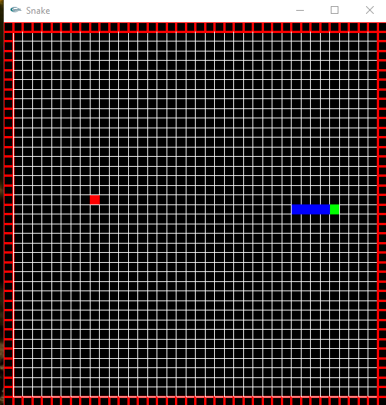
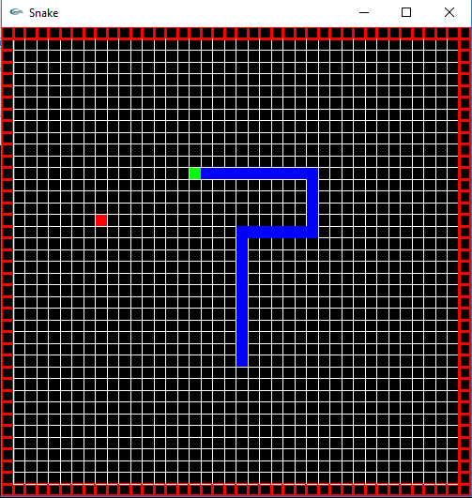
Screenshots

Slide 7
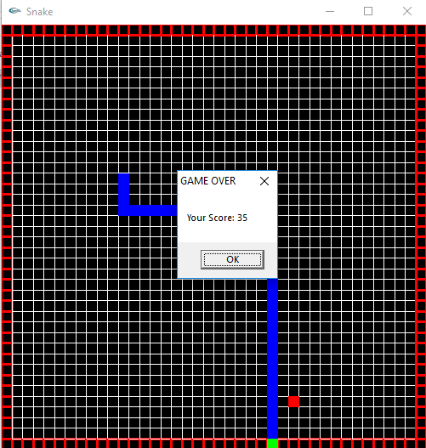
Screenshots

Slide 8
THANK YOU

